Slide 1
Final Project Review
“A Healthcare Monitoring System based on IoT
using a Network of Body Sensors”
Guide :- Prof. Anbarasi M.
Adithya V.
13 BCE 0193
N. Ajit Kumar
13 BCE 0480
K.J. Sai Krishna
13 BCE 0199

Slide 2
Problem Statement
In Today's modern world, People in Rural areas and in remote places like Hilly areas etc. do not have access to high-level sophisticated modern healthcare equipment. Most highly-qualified Doctors and Physicians are looking to work and settle in High-tech Metro cities like Mumbai, Chennai, Delhi, Hyderabad etc. This makes for the people in Rural and remote areas, very difficult to access them in case of any emergency.
So, using different modern technological developments like IoT, Sensors, Mobile transmission etc. we are developing a modern healthcare monitoring system through which any patient can be monitored remotely by physicians or Doctors without actually physically being present near the patient.

Slide 3
Overview
Advances in information and communication technologies have led to the emergence of Internet of Things (IoT). In the modern health care environment, the usage of IoT technologies brings convenience of physicians and patients, since they are applied to various medical areas (such as real-time monitoring, patient information management, and healthcare management). The body sensor network (BSN) technology is one of the core technologies of IoT developments in healthcare system, where a patient can be monitored using a collection of tiny-powered and lightweight wireless sensor nodes. However, the development of this new technology in healthcare applications without considering security makes patient privacy vulnerable. In this paper, at first, we highlight the major security requirements in BSN-based modern healthcare system. Subsequently, we propose a secure IoT-based healthcare system using BSN, called BSN-Care, which can efficiently accomplish those requirements.

Slide 4
Motivation
The motivation behind proposing this system is the existing system having many drawbacks which can only be solved by developing an efficient system for combating the issues/drawbacks found in the existing system. The existing system involves no Self Healthcare monitoring and management system and also the method for taking time to hospitals is energy and time consuming. Besides, there is no RFID technology is used in healthcare systems
The various drawbacks involve issues such as the efficiency of the system in producing proper results required for the patient and for the doctor to examine them properly such as increase of manual work which again increases the man power and also a very time consuming process.

Slide 5
Objective
The central objective of this project is to monitor the state of health of patients and provide information in real time to doctors who assist for security purpose. Similarly, also the readings that do permanently to patients reports, doctors recommend also workout routines that allow them to improve the quality of life and overcome such diseases. The internet of things applied to the care and monitoring of patients is increasingly common in the health sector, seeking to improve the quality of life of people.

Slide 6
Abstract
This project presents the usage of IoT technologies, brings convenience of physicians and patients since they are applied to various medical areas such as real-time monitoring, patient information management, and healthcare management. The body sensor network technology is one of the core technologies of IoT developments in healthcare system, where a patient can be monitored using a collection of tiny-powered and lightweight wireless sensor nodes.
Advances in information and communication technologies have led to the emergence of Internet of Things (IoT). In the modern health care environment, the usage of IoT technologies brings convenience of physicians and patients since they are applied to various medical areas (such as real-time monitoring, patient information management, and healthcare management). The body sensor network technology is one of the core technologies of IoT developments in healthcare system, where a patient can be monitored using a collection of tiny-powered and lightweight wireless sensor nodes. However, development of this new technology in healthcare applications without considering security makes patient privacy vulnerable. In this project, we design an IoT based healthcare system using BSN, which can efficiently accomplish those requirements.

Slide 7
Body Sensor Network (BSN) allows the integration of intelligent, miniaturized low-power sensor nodes in, on or around human body to monitor body functions and the surrounding environment. It has great potential to revolutionize the future of healthcare technology and attained several researchers both from the academia and industry in the past few years.

Slide 8
Literature Survey
With the intention of achieving a broad standpoint, we explored widely in internet sources.
The databases sheltered are:
ACM Digital Library (<portal.acm.org>)
IEEE eXplore (<ieeexplore.ieee.org>)
Springer LNCS (<www.springer.com/Incs>)
Google Scholar
Inspec (<www.theiet.org/publishing/inspec/>)
These databases shelter the most pertinent journals and conference & workshop proceedings.

Slide 9
In [1], the Body Sensor Network has been introduced and explained. Also, the potential use of it in Medical Healthcare system has also been mentioned.
In [2], a design of Fuzzy Logic controller has been discussed to read such data received from sensors which is imprecise or crisp. The FLC system receives context information from sensor as input (which is in crisp form) and the fuzzification module converts input into fuzzy linguistic variable and output is sent to Patient / Doctor which can be easily understood by common person.
The paper [3] presents a remote measuring and monitoring system for ECG, lung functioning (spirometer), heart rate and temperature signals. Use of ZigBee, radio frequency (RF) trans-receiver circuits for Healthcare is discussed.
In [4], an adaptive load control algorithm for ZigBee-based WBAN/WiFi coexistence environments has been proposed, with the aim of guaranteeing that the delay experienced by ZigBee sensors does not exceed a maximally tolerable period of time.
In [5], A critical evaluation of the existing literature, which discusses the effective ways to deploy IoT in the field of medical and smart health care has been done. Also, a model providing a platform for accessing patients’ health data using smart phones has been proposed.

Slide 10
In [6], CodeBlue, a wireless infrastructure intended for deployment in emergency medical care, integrating low-power, wireless vital sign sensors, PDAs, and PC-class systems was introduced. It will enhance first responders’ ability to assess patients on scene, ensure seamless transfer of data among caregivers, and facilitate efficient allocation of hospital resources. We use this technology's architecture as a reference in our project as this infrastructure will support reliable, data delivery, a flexible naming and discovery scheme, and a decentralized security model.
In [7], it has been envisioned that a common protocol and software framework could integrate devices such as wearable vital sign sensors, handheld computers, and location tracking tags into disaster response scenarios. Thr CodeBlue architecture is being proposed as the suitable one for achieving the above stated objective in Medical field.
The aim of the paper [8] is to address issues related to using wearable or implantable sensors for distributed mobile monitoring. A ubiquitous monitoring system is presented for continuous monitoring of patients under their natural physiological states. It provides the architecture for collecting, gathering and analyzing data from a number of biosensors.
In [9], they have introduced MEDiSN, a wireless sensor network for monitoring patients’ physiological data in hospitals and during disaster events.
In paper [10] a lightweight, secure, and an expeditious authentication scheme has been proposed, which can preserve the user anonymity using low-cost cryptographic primitives such as one-way hash functions and EXCLUSIVE-OR operations, which are most suitable for battery-powered mobile devices.

Slide 11
Block Diagram
LCD
PIC MICRO CONTROLLER
TEMPERATURE SENSOR
WSN
Transmitter →
RESPIRATORY SENSOR
HEART BEAT SENSOR
POWER SUPPLY

Slide 12
INTERNET OF THINGS
(IOT)
Server →
WSN

Slide 13
Proposed System
The proposed system consists of major requirements in modern healthcare system.
An IoT based healthcare system, using Body Sensor Network, which can efficiently accomplish healthcare requirements, is proposed.
The main advantage of this system is to determine and deliver the patient’s medical records and also maintaining the data integrity and authentication.
The purpose of the proposed scheme is to resolve several issues existing in BSN based healthcare system and also to guarantee reasonable computational overhead.

Slide 14
Methodology
Our BSN-Care is a BSN architecture composed of wearable sensors. Each sensor node is integrated with bio-sensors such as Blood Pressure (BP), Temperature Sensor etc. These sensors collect the physiological parameters and forward them to a coordinator called Local Processing Unit (LPU), which can be a portable device such as PDA, smart-phone etc. The LPU works as a router between the BSN nodes and the central server called BSN-Care server, using the wireless communication mediums such as mobile networks 3G/CDMA/GPRS. Besides, when the LPU detects any abnormalities then it provides immediate alert to the person that wearing the bio-sensors. For example, in general BP less than or equal to 120 is normal, when the BP of the person reaches say 125, the LPU will provide a gentle alert to the person through the LPU devices (e.g. beep tone in a mobile phone).
When the BSN-Care server receives data of a person (who wearing several bio sensors) from LPU, then it feeds the BSN data into its database and analyzes those data. Subsequently, based on the degree of abnormalities’, it may interact with the family members of the person, local physician, or even emergency unit of a nearby healthcare center.

Slide 15
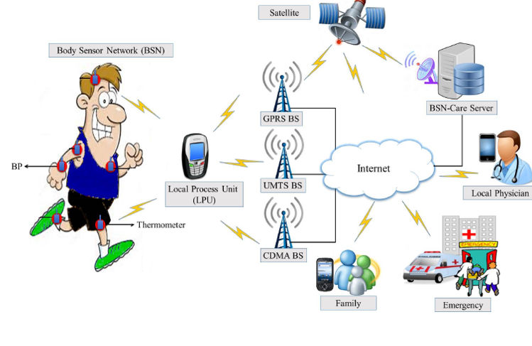
Pictorial Representation of Objective and Mechanism

Slide 16
Hardware Requirements
PIC16F877A
One of the main advantages is that it can be write-erase as many times as possible because it uses FLASH memory technology.
PIC microcontrollers (Programmable Interface Controllers), are electronic circuits that can be programmed to carry out a vast range of tasks. They can be programmed to be timers or to control a production line.
It has a total number of 40 pins and there are 33 pins for input and output.
PIC16f877A has applications in a huge number of devices. It is used in remote sensors, security and safety devices, home automation etc.

Slide 17
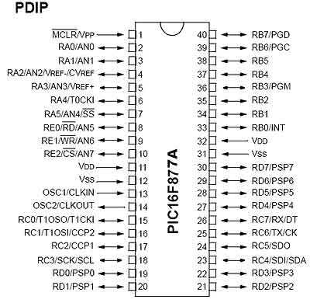

Slide 18
Temperature Sensor
Temperature Sensors measure the amount of heat energy or even coldness that is generated by an object or system, allowing us to “sense” or detect any physical change to that temperature producing either an analogue or digital output.
A temperature sensor is a device, typically, a thermocouple or RTD, that provides for temperature measurement through an electrical signal. A thermocouple (T/C) is made from two dissimilar metals that generate electrical voltage in direct proportion to changes in temperature.
Respiratory Sensor
The Respiration Sensor is used to monitor abdominal or thoracic breathing, in biofeedback applications such as stress management and relaxation training. Besides measuring breathing frequency, this sensor also gives you an indication of the relative depth of breathing.

Slide 19
Heart Beat Sensor
Using a heartbeat sensor heart Beat can be measured based on optical power variation as light is scattered or absorbed during its path through the blood as the heart beat changes.
The heartbeat sensor is based on the principle of photo plethysmography. It measures the change in volume of blood through any organ of the body which causes a change in the light intensity through that organ.
LCD
LCDs are most commonly used because of their advantages over other display technologies. They are thin and flat and consume very small amount of power compared to LED displays and cathode ray tubes (CRTs).

Slide 20
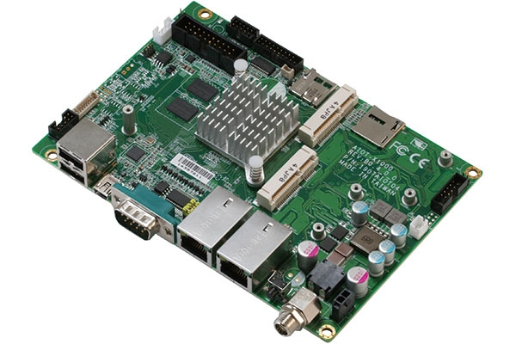
IoT Board
The Internet of things (IoT) is the internetworking of physical devices, vehicles (also referred to as "connected devices" and "smart devices"), buildings, and other items—embedded with electronics, software, sensors, actuators, and network connectivity that enable these objects to collect and exchange data.

Slide 21
Software Requirements
MPLAB IDE
MPLAB IDE is an integrated toolset for the development of embedded applications on Microchip's PIC and dsPIC microcontrollers.
It is called an Integrated Development Environment, or IDE, because it provides a single integrated environment to develop code for embedded microcontrollers.
Embedded C
As, embedded C is generally an extension of the C language. C is generally used for desktop computers, while embedded C is for microcontroller based applications.

Slide 22
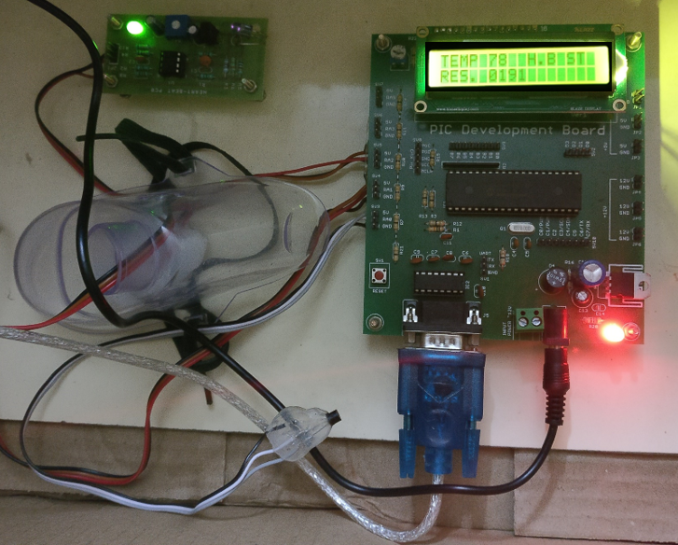
Screenshots

Slide 23
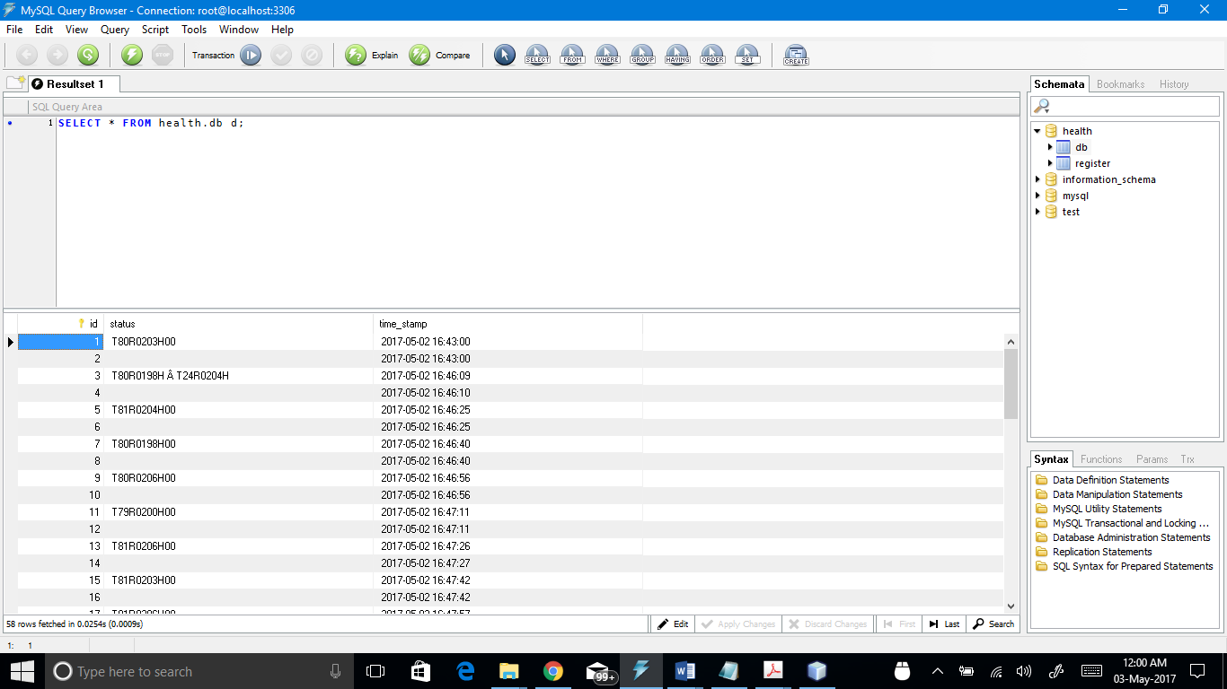

Slide 24


Slide 25
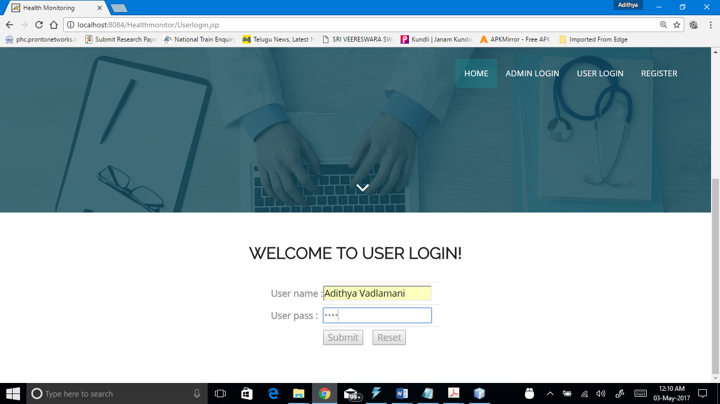

Slide 26
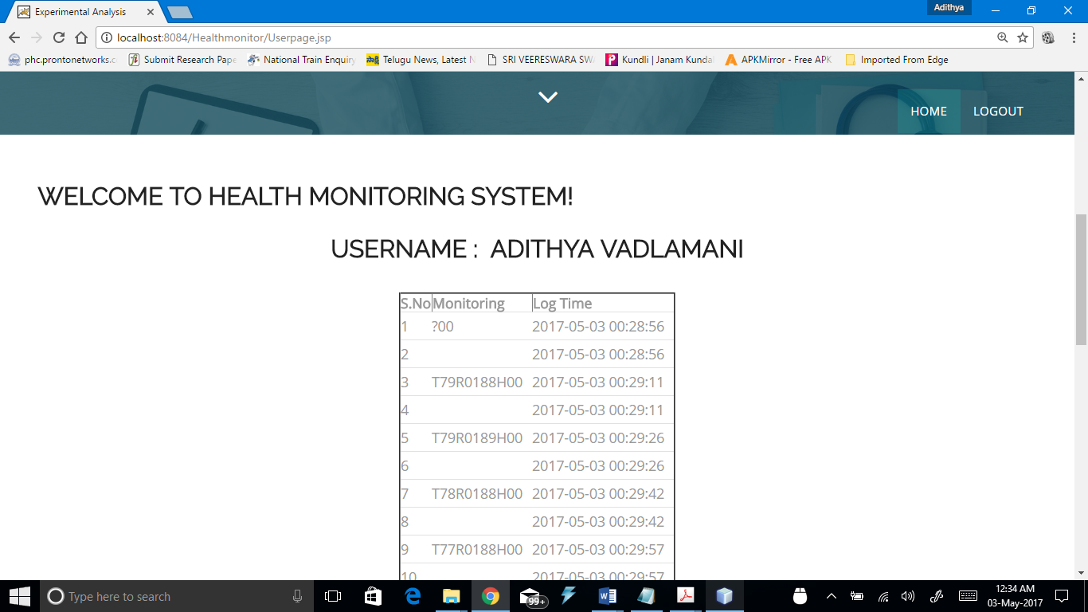

Slide 27
Conclusion and Future Enhancement
In this project, at first we have described the issues in healthcare applications using body sensor network (BSN). Subsequently, we found that even though most of the popular BSN based research projects acknowledge the issues, but they fail to embed strong services that could serve patients remotely. Finally, we proposed an IoT based healthcare system using BSN, called BSN-Care, which can efficiently accomplish various requirements of the BSN based healthcare system.
The system can carry out a long-term monitoring on patient’s condition and is equipped with an emergency rescue mechanism using SMS. This system can be enhanced by acquiring other health parameter from the patient’s body.

Slide 28
References
Body Sensor Network – A Wireless Sensor Platform for Pervasive Healthcare Monitoring [Benny P.L. Lo, Surapa Thiemjarus, Rachel King and Guang-Zhong Yang] 2015.
Fuzzy Logic based Health Care System using Wireless Body Area Network [PrakashgoudPatil, Samina Mohsin, Karnataka, India] 2014.
A Unique Health Care Monitoring System Using Sensors and Zig Bee Technology [EktaMadhyan Mahesh Kadam, Department of Electronics & Telecommunications, Mumbai University, India] 2013
Coexistence of zigbee-based WBAN and WiFi for Health Telemonitoring Systems [Yena Kim, Student Member, seung seob Lee, Student Member, and sukyoung Lee, Member,] 2013
Effective Ways to Use Internet of Things in the Field of Medical and Smart Health Care. [Kaleemullah, Munam Ali Shah, Sijing Zhang, Department of Computer Science, University of Bedfordshire, Luton, UK] 2015.
D. Malan, T. F. Jones, M. Welsh,S. Moulton, "CodeBlue: An Ad-Hoc Sensor Network Infrastructure for Emergency Medical Care," Proceedings of the MobiSys 2004 Workshop on Applications of Mobile Embedded Systems (WAMES 2004); Boston, MA, USA. 6–9 June 2004.

Slide 29
K. Lorincz, D. J. Malan, T. R. F. Fulford-Jones, A. Nawoj, A. Clavel, V. Shayder, G. Mainland, M. Welsh, "Sensor Networks for Emergency Response: Challenges and Opportunities", Pervas. Comput. vol.3, pp.16–23, 2004.
J.W.P. Ng, B.P.L Lo, O. Wells, M. Sloman, N. Peters, A. Darzi, C. Toumazou, G. Yang, "Ubiquitous Monitoring Environment for Wearable and Implantable Sensors (UbiMon)," Proceedings of 6th International Conference on Ubiquitous Computing (UbiComp’04); Nottingham, UK. 7–14 September 2004.
J. Ko, J. H. Lim, Y. Chen, R. Musaloiu-E, A. Terzis, G. M. Masson, "Median: Medical Emergency Detection in Sensor Networks," ACM Trans. Embed. Comput. Syst. vol. 10, pp. 1–29, 2010.
P. Gope, T. Hwang, “Lightweight and Energy Efficient Mutual Authentication and Key Agreement Scheme with User Anonymity for Secure Communication in Global Mobility Networks,” IEEE Systems Journal, DOI: 10.1109/JSYST.2015.2416396, 2015.

Slide 30
Thank You

